Slide 1

Conference booking systems
Tec ballerup

Slide 2
Tech EQUIPMENT
2 PC
1 Raspberry Pi
1 Switch

Slide 3

LAMP - stack
Linux
Apache
PHP
MariaDB

Slide 4
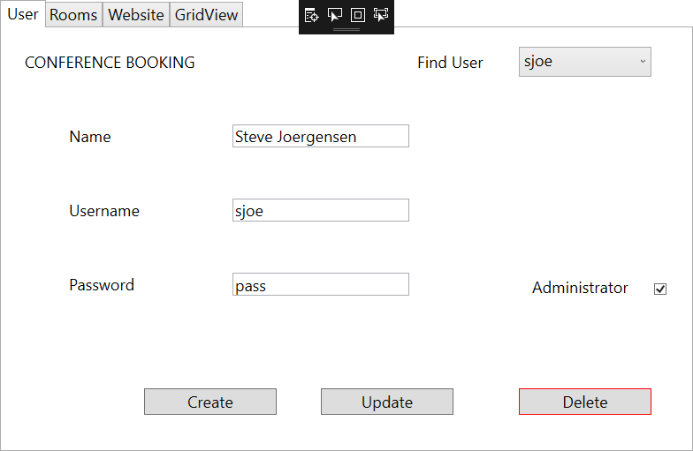
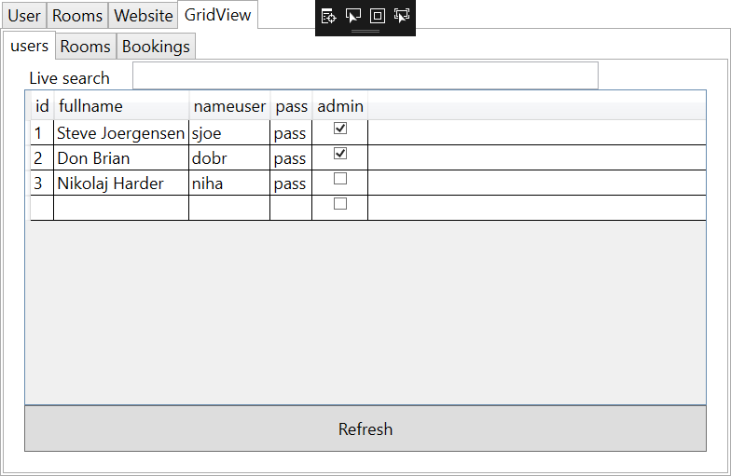
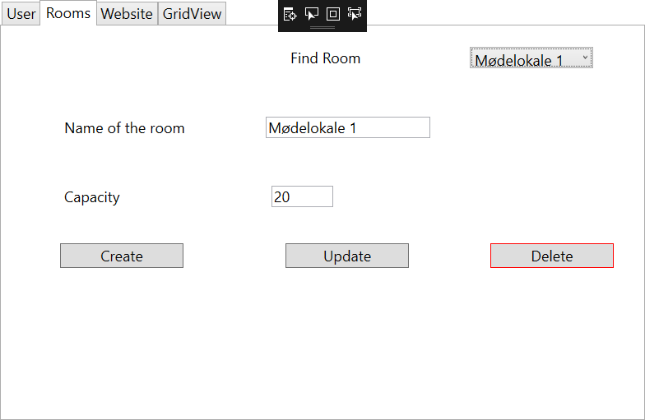
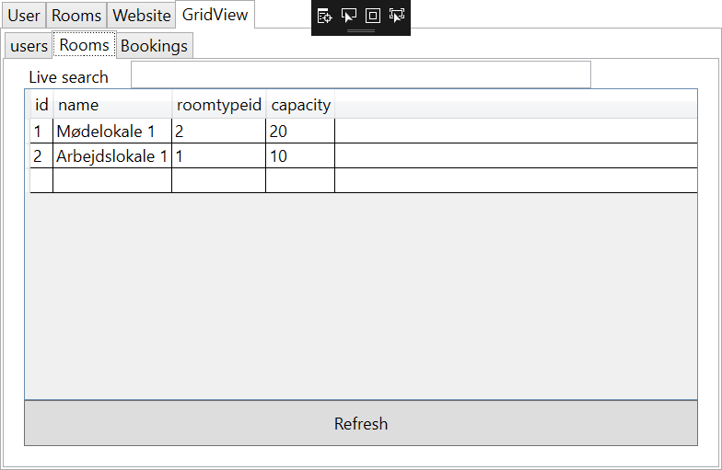
Wpf aPPLICATION
Create user
Create room
Grid views

Slide 5
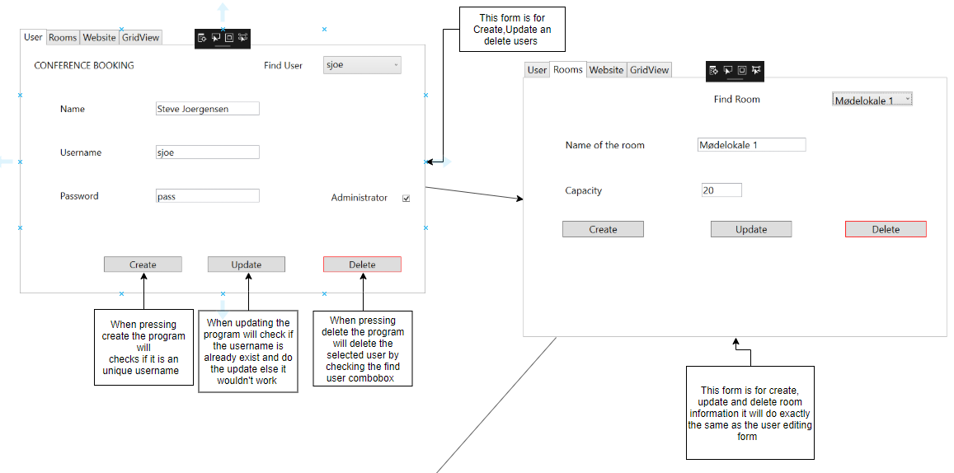
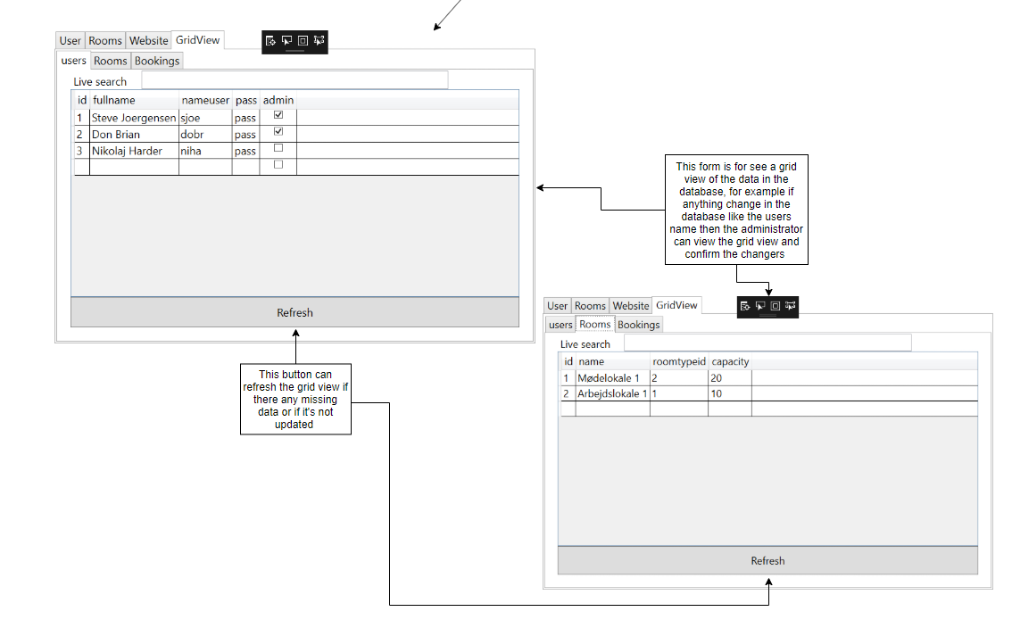

Slide 6
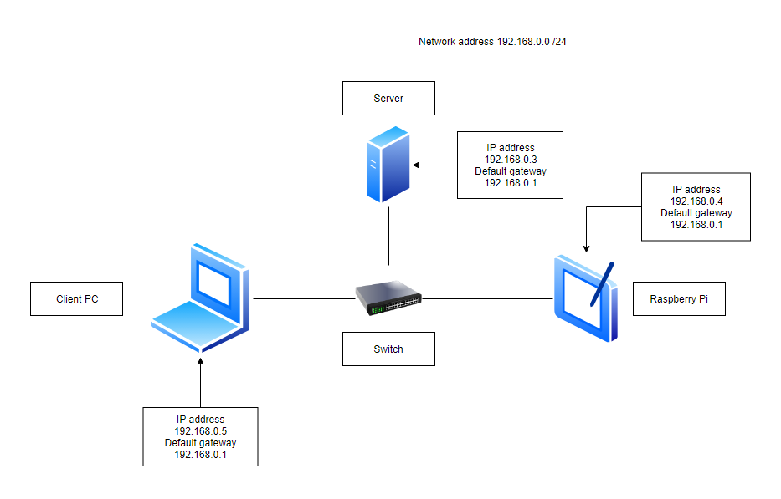
Network TOPOLOGI
IP ADDRES /24
PING

Slide 7
Website

Slide 8
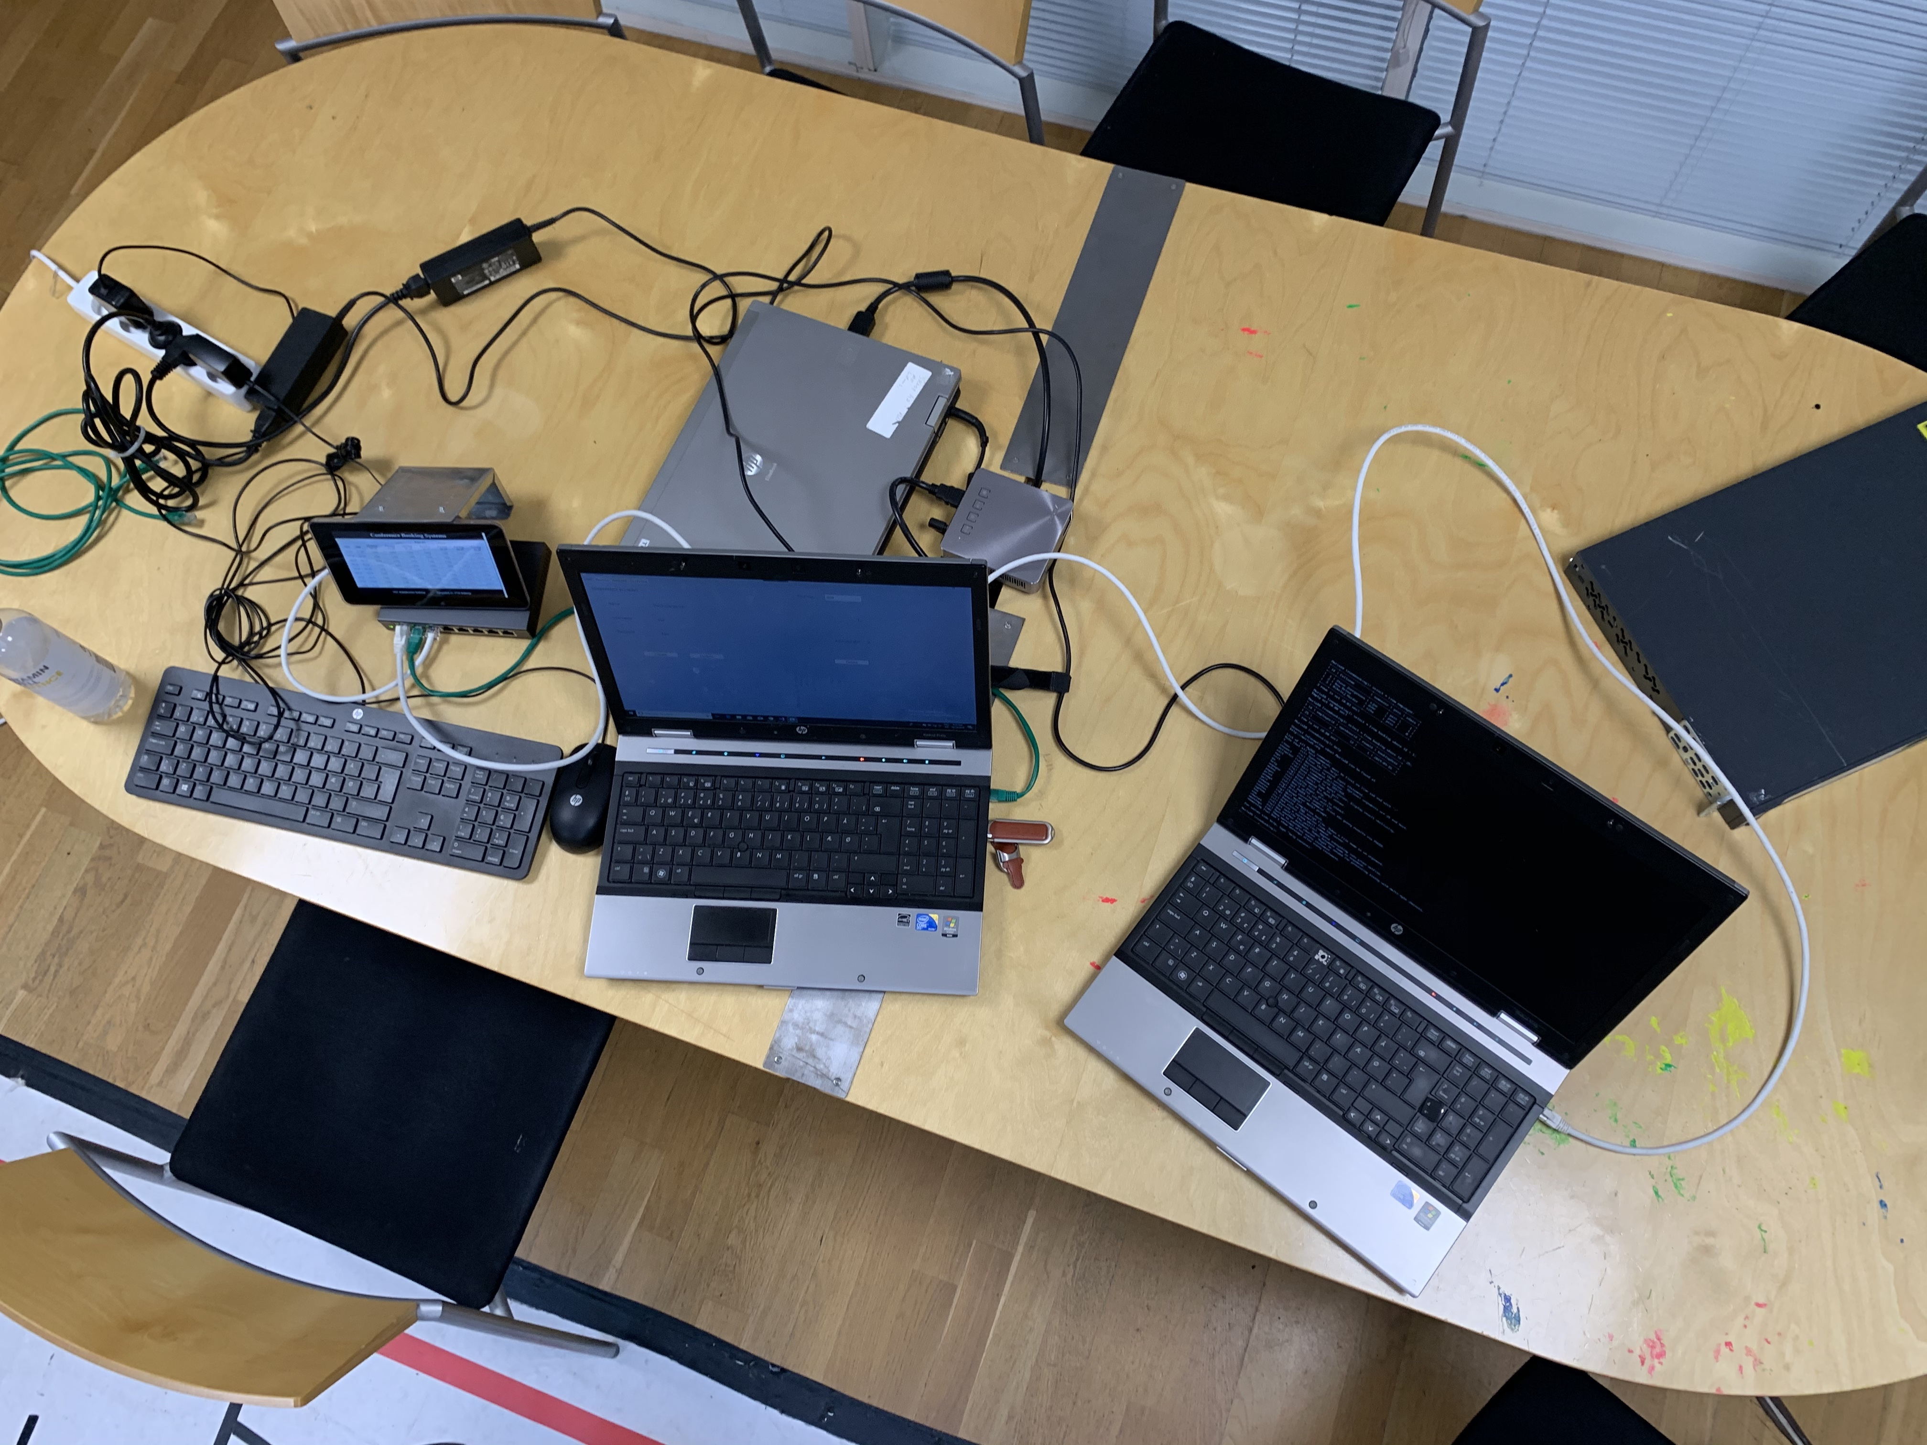
Physical setup

Slide 9
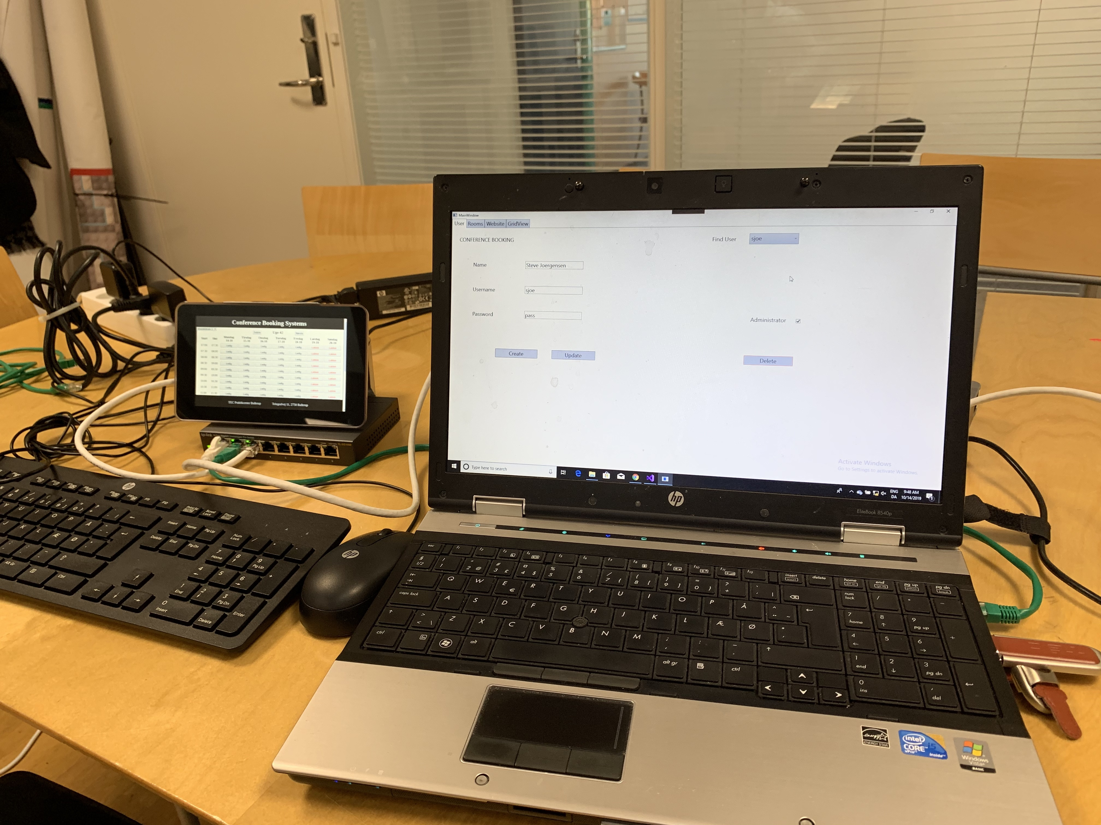
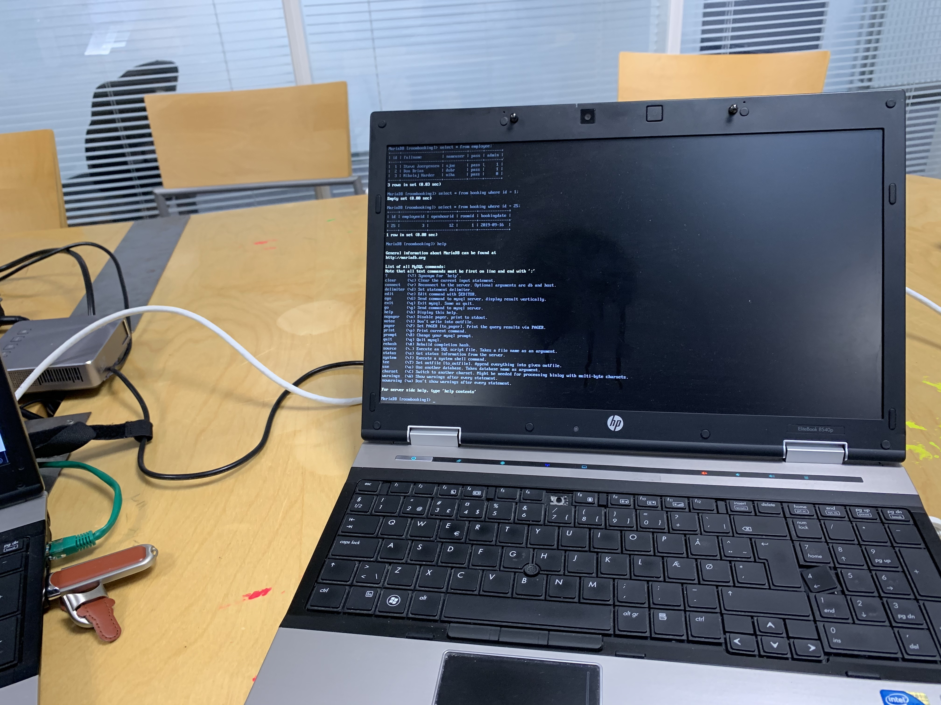
Devices we user
RASPBERRY PI
SWICH
WINDOWS
LINUX

Slide 10

Thank You
K A D D Brian Nanayakkara
Nikolaj Harder

